Slide 1
The DSpace Course
Module - Look & Feel Customisation

Slide 2
Module Objectives
By the end of this module you will:
  Understand the different user interfaces to the DSpace software
  Understand the different levels of customisation that can be done to the DSpace interface
  Have customised the JSPUI interface of DSpace

Slide 3
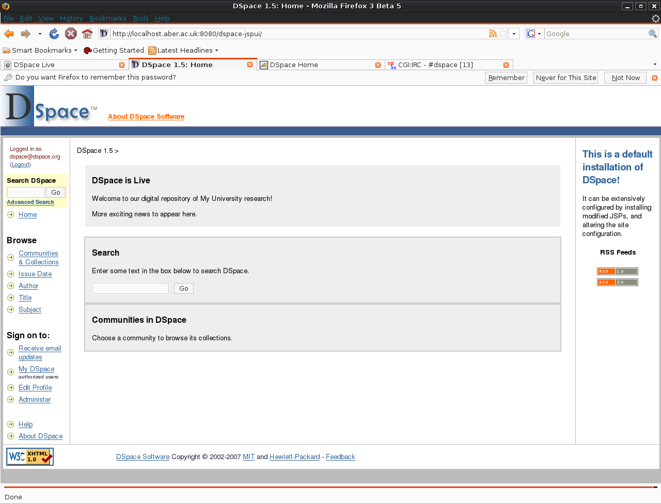
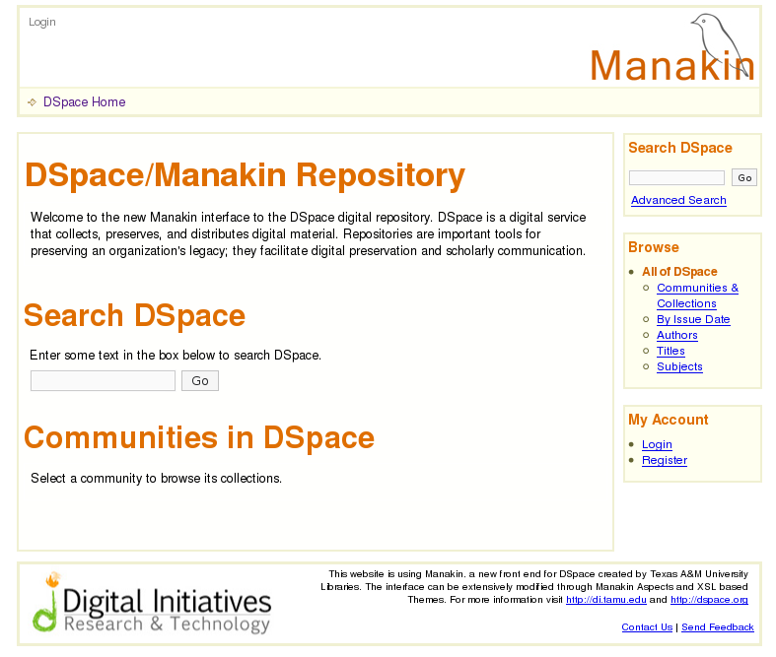
The DSpace Interface
There are two interfaces to DSpace 1.5
  The JSPUI (Java Server Pages)
  The XMLUI (Manakin Framework)
JSPUI
XMLUI

Slide 4
JSPUI - [dspace.url/jspui]
The JSPUI is the standard interface for DSpace allowing fast creation of dynamic web content
The JSPUI interface is implemented using:
  Java Servlets which handle the business logic
  JavaServer Pages (JSPs) which produce the HTML
The source code for the JSP webapp is located either:
[dspace-src]\dspace-jspui\dspace-jspui-webapp\src\main\webapp
If the full source was downloaded
[dspace-src]\dspace\target\dspace-[version].dir\webapps\dspace-jspui-webapp\
If the default release was downloaded after the first build

Slide 5
The JSPUI
Edited JSPs should be placed in
[dspace-src]/dspace/modules/jspui/src/main/webapp/
Files placed in this directory will overwrite the original JSPs
This will ensure when upgrading DSpace local changes are not overwritten
Using the same path as the original
DSpace default | Locally-modified version
[jsp.dir]/community-list.jsp | [dspace-src]/dspace/modules/jspui/src/main/webapp/community-list.jsp
[jsp.dir]/mydspace/main.jsp | [dspace-src]/dspace/modules/jspui/src/main/webapp/mydspace/main.jsp

Slide 6
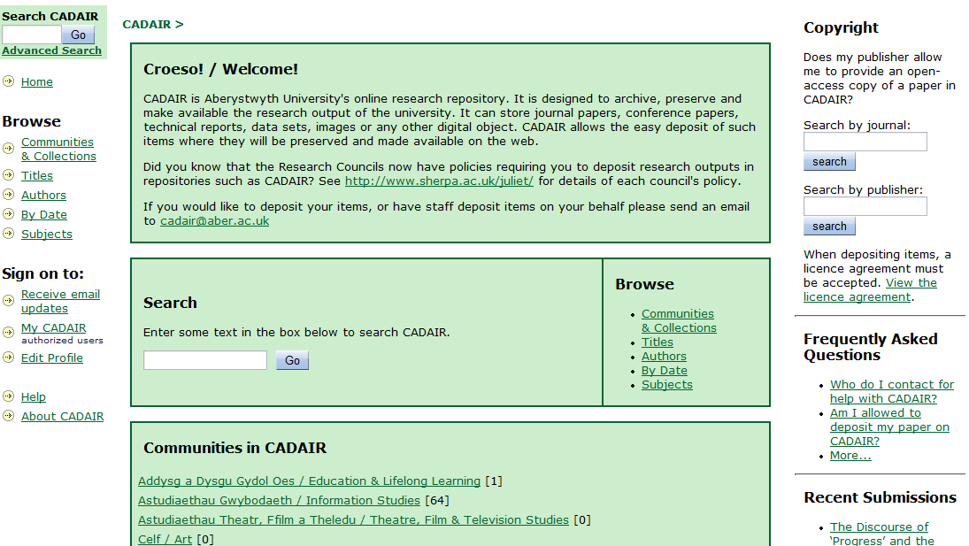
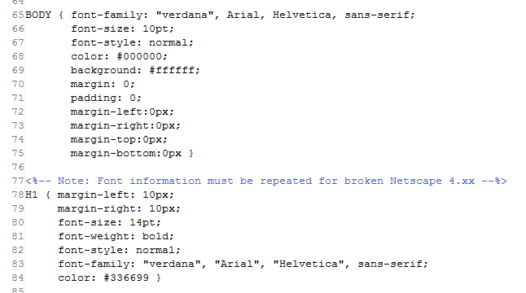
Customising the Stylesheet
Fonts, colours and formatting in DSpace can be easily changed using the stylesheet
When editing the stylesheet copy the local version to:
[dspace-src]/dspace/modules/jspui/src/main/webapp/styles.css.jsp

Slide 7
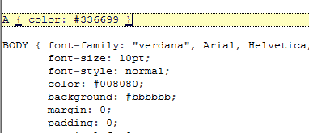
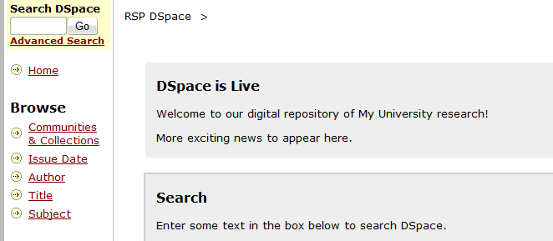
Editing the Stylesheet
Tags within the stylesheet relate to various elements in the JSPUI
By changing these tags, fonts, colours and formatting can be modified
Once this file has been modified DSpace will need to be re-packaged
  cd [dspace-src]\dspace
  mvn package
Then DSpace will need to be redeployed
  cd [dspace-src]\dspace\target\[version]\dspace-[version].build.dir
  ant –Dconfig=[dspace]\config\dspace.cfg update
So lets see an example on the DSpace LiveCD

Slide 8





Page Structure
Page elements for the basic layout are located in layout\*.jsp
Header
Navigation Bar
Content
Sidebar
Footer

Slide 9

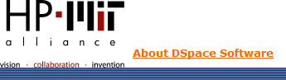
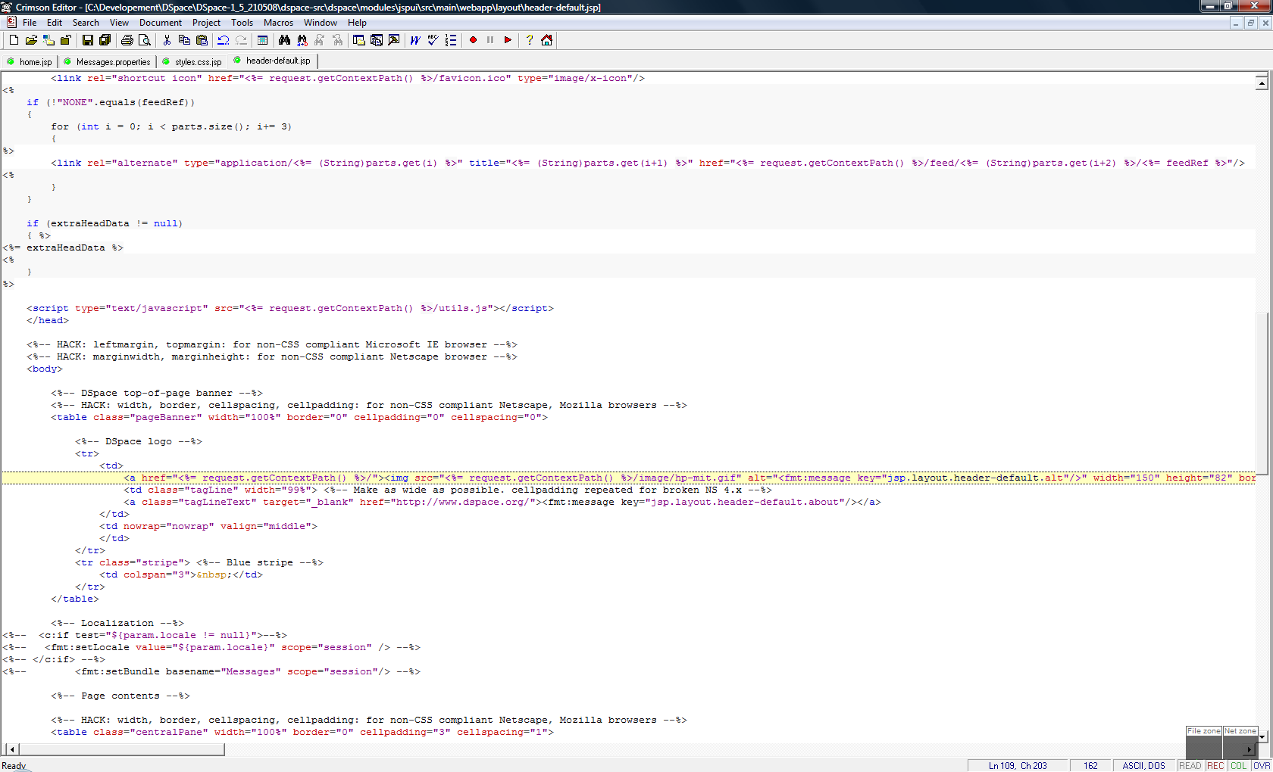
Customising a JSP
More advanced customisation can be done by editing the JSPs
Editing layout\header-default.jsp to modify the DSpace logo
Once this file has been modified DSpace will need to be re-packaged
  cd [dspace-src]\dspace
  mvn package
Then DSpace will need to be redeployed
  cd [dspace-src]\dspace\target\[version]\dspace-[version].build.dir
  ant –Dconfig=[dspace]\config\dspace.cfg update
So lets see an example on the DSpace LiveCD

Slide 10
Type of Customisation - Simple
Simple Customisation to the JSPUI involves:
  Basic changes to the page elements
  Changes to the stylesheet
Advantages:
  Quick to implement
  Simple to complete (only a basic understanding of CSS/HTML is required)
Disadvantages:
  Only very basic changes to the look and feel can be completed
  DSpace look & feel does not very greatly from the ‘out of the box’ installation

Slide 11
Type of Customisation - Advanced
Advanced Customisation to the JSPUI involves
  JSPUI Interface - Editing Java Server Pages (JSPs) etc...
  Changes to the stylesheet
Advantages:
  Advanced changes to the look and feel can be achieved
  DSpace can be branded to match the organisational corporate scheme
Disadvantages:
  Changes can be time consuming
  Changes require knowledge of additional programming languages (Java/Java Server)

Slide 12
JSP UI Examples
(Advanced Customisation of the JSP Interface)

Slide 13
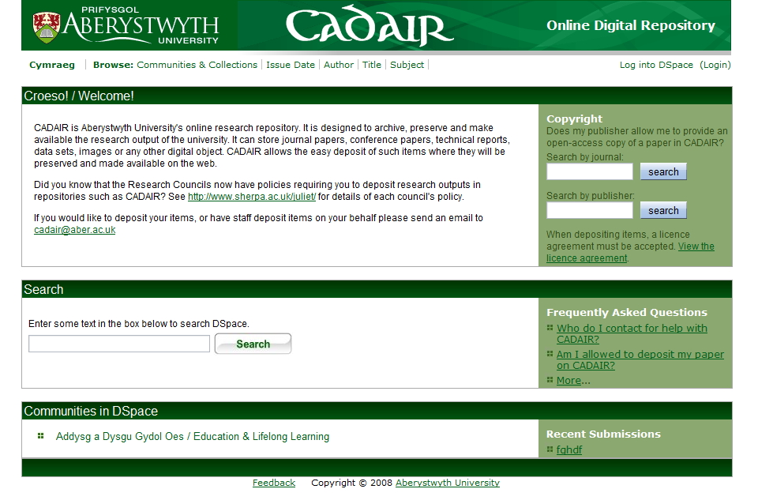
Advanced Customisation - JSPUI
Aberystwyth University Repository

Slide 14
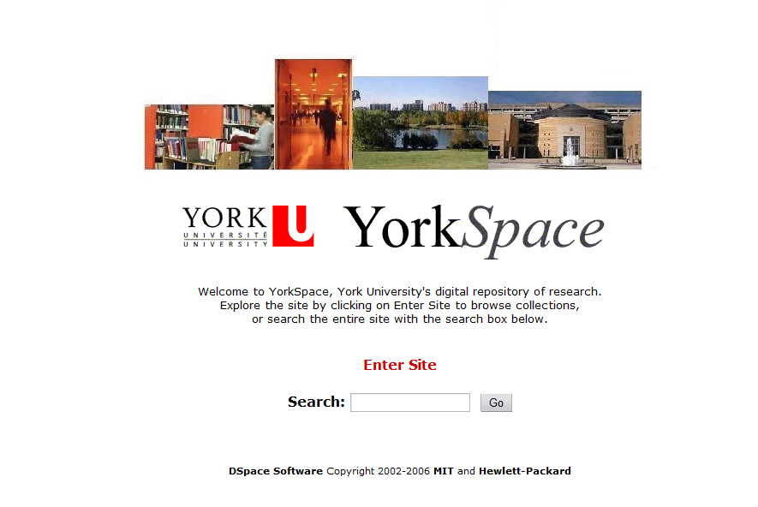
Advanced Customisation - JSPUI
York University Repository

Slide 15
XMLUI – [dspace.url/xmlui]
XMLUI is a new front end for DSpace
Based on Apache Cocoon Framework
Why? Four Design Goals
  allowing each community and collection represented in DSpace to maintain a distinct look and feel.
  to increase support for internationalization in DSpace
  to separate the business logic from stylistic controls, increasing ease of adaptability.
  to provide an alternative interface to the current JSP based implementation, requiring no changes to the core of DSpace (including the database), while specifically enabling both user interfaces to operate simultaneously.
Additional Information on Manakin can be found at:
  http://di.tamu.edu/projects/xmlui

Slide 16
XML UI Examples
(Advanced Customisation of the XML Interface)

Slide 17
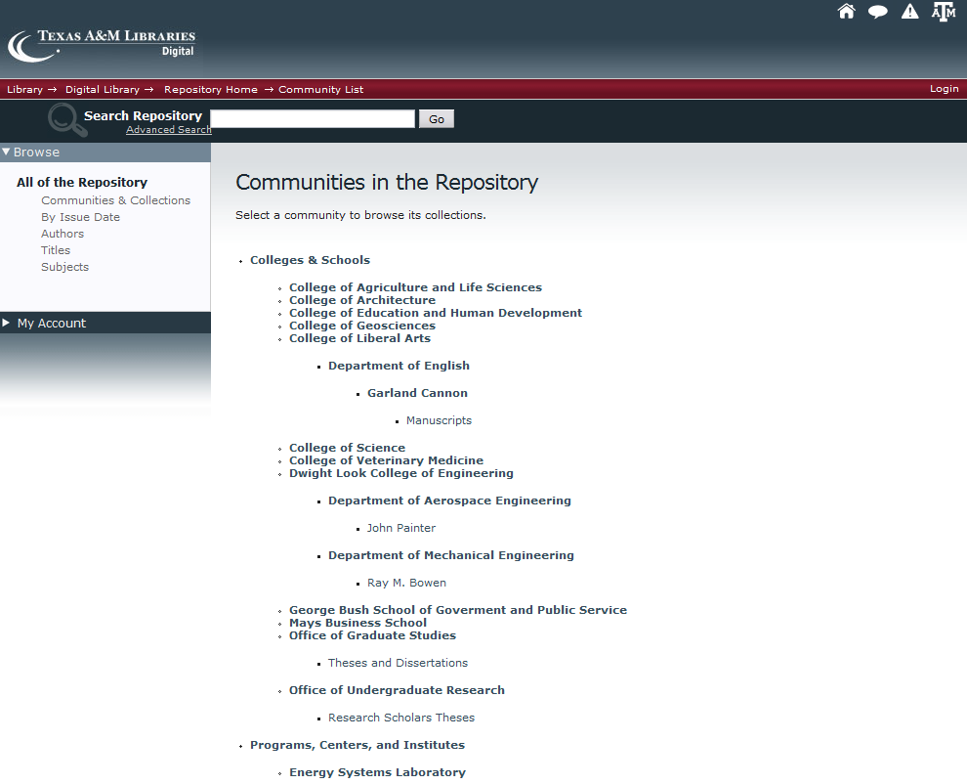
Advanced Customisation - XMLUI
Texas A&M Repository

Slide 18
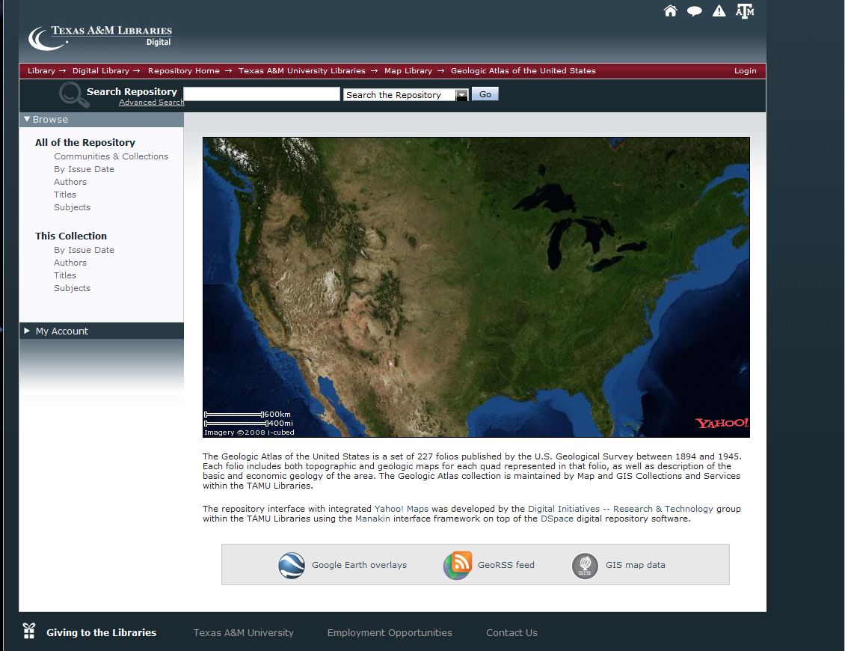
Advanced Customisation - XMLUI
Texas A&M Repository

Slide 19
Practical: DSpace Customisation
Try customising the following using the guide in the workbook:
  DSpace Stylesheet
  DSpace JSPs

Slide 20



Credits
These slides have been produced by:
  Stuart Lewis & Chris Yates
  Repository Support Project
    http://www.rsp.ac.uk/
  Part of the RepositoryNet
  Funded by JISC
    http://www.jisc.ac.uk/

